Slide 1
Ecommerce Project
Overview of Product Searching and Admin Login

Slide 2
Introduction
This presentation covers critical aspects of product searching and admin login in an ecommerce project. We will discuss search algorithms, filtering options, and the importance of secure admin login processes.

Slide 3
01
Product Search

Slide 4
Search Algorithms
Search algorithms are essential for retrieving relevant products from a database. Common algorithms include binary search and fuzzy search, which enhance the user experience by providing accurate results quickly. Understanding the backend workings ensures implementation of effective search techniques.

Slide 5
Filtering Options
Filtering options allow users to narrow down search results based on specific criteria such as price, category, and ratings. Implementing comprehensive filtering improves user satisfaction by enabling them to find products that meet their needs and preferences more efficiently.

Slide 6

Search Result Optimization
Optimizing search results involves improving the relevance and ranking of products displayed to users. Techniques include using algorithms that analyze user behavior, incorporating synonyms, and implementing advanced natural language processing. The goal is to enhance user satisfaction by providing the most pertinent results at the top of the list.

Slide 7
02
Admin Login

Slide 8

Authentication Methods
Authentication methods for admin login may include username and password authentication, two-factor authentication (2FA), and biometric verification. Each method increases security and protects sensitive information, ensuring that only authorized personnel can access admin capabilities.

Slide 9
User Role Management
User role management involves defining access levels for different users within the admin interface. By assigning roles such as administrator, editor, and viewer, businesses can protect sensitive data while allowing team members to perform necessary tasks without jeopardizing system security.

Slide 10
Session Security
Session security is crucial in maintaining the integrity of an admin login. Techniques include session timeouts, secure cookie management, and monitoring for suspicious activity. Ensuring robust session security helps to protect against unauthorized access and potential security breaches.

Slide 11
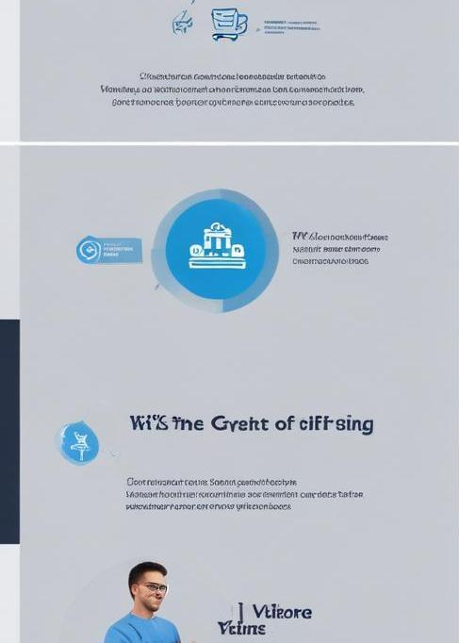
Conclusions
In conclusion, effective product searching and secure admin login processes are pivotal for the success of an ecommerce project. Optimizing search results and managing user roles with robust authentication methods enhances user experience and protects sensitive information.

